Slide 1
Pandas Package

Slide 2
DataFrame Review

Slide 3
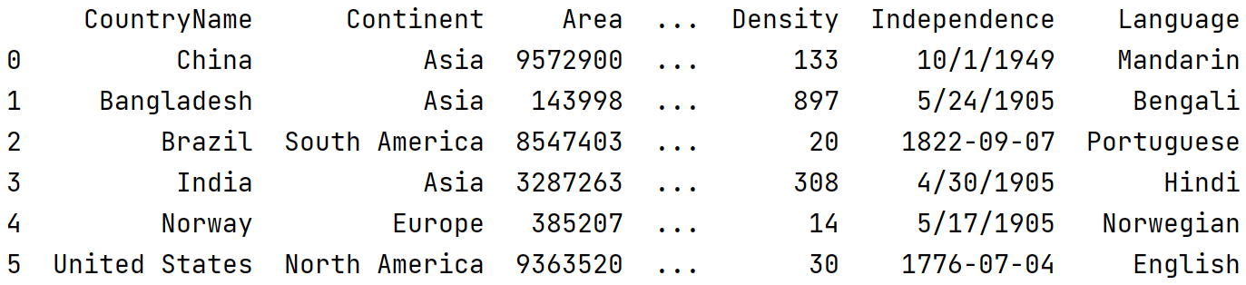
DataFrame methods: drop()
drop(index=None, labels=None, axis=0, inplace=False)
result = country.drop(columns=['Percentage']) print(result)

Slide 4
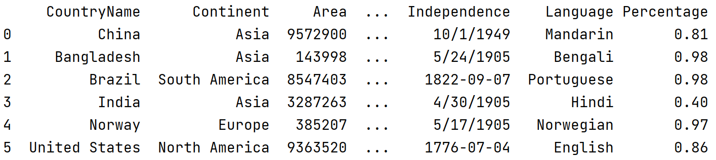
DataFrame methods: drop()
result = country.drop(columns=['Percentage’]) print(country)
result = country.drop(columns=['Percentage’], inplace=True)

Slide 5
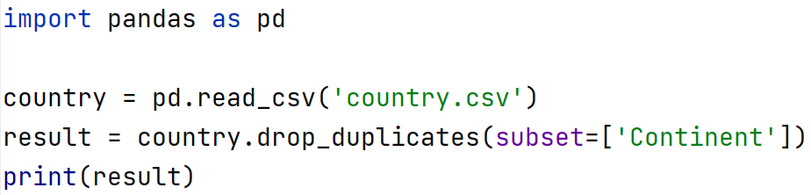
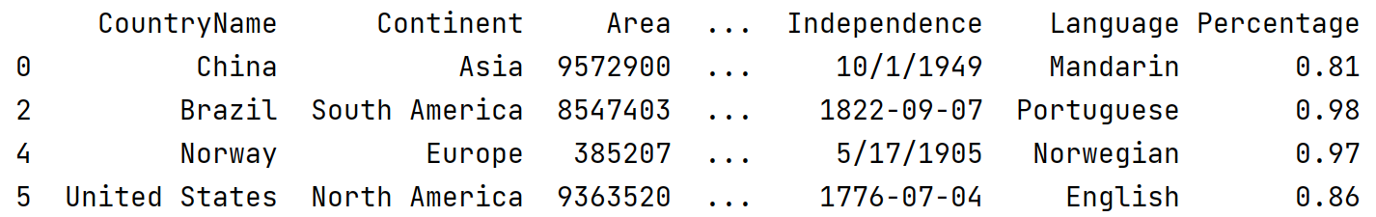
DataFrame methods: drop_duplicates()
drop_duplicates(subset=None, inplace=False)

Slide 6
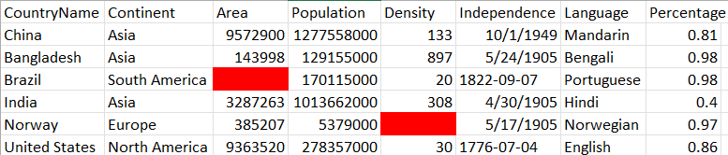
DataFrame methods: dropna()
Removes rows (axis=0) or columns (axis=1) containing missing values from dataframe
#Drop the rows with missing values
result = country.dropna(axis=0) print(result)

Slide 7
DataFrame methods: dropna()
Removes rows (axis=0) or columns (axis=1) containing missing values from dataframe
#Drop the columns with missing values
result = country.dropna(axis=1) print(result)

Slide 8

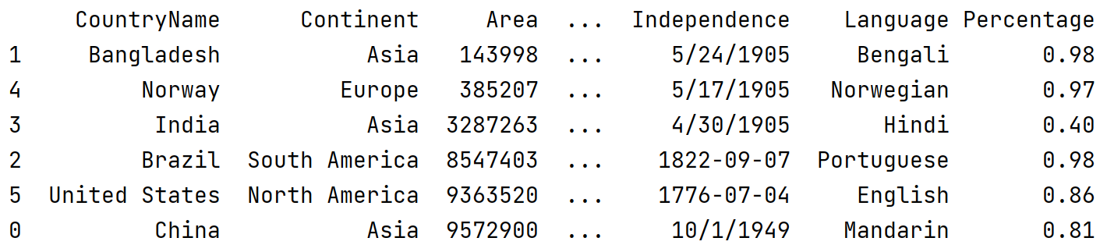
DataFrame methods: sort_values()
Sorts dataframe columns or rows
#Sorting in descending order
result = country.sort_values(by='Area', ascending=False)

Slide 9
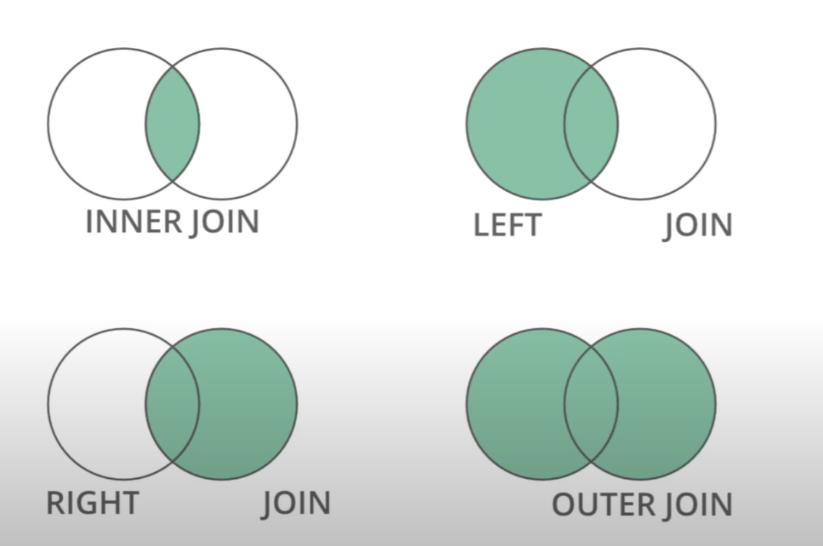
Merging DataFrames
DataFrame.merge(leftdataframe,rightdataframe, how=‘outer’,
on=None

Slide 10
Student
Registration
Inner
Panther ID | Name
1 | Michael
2 | Henry
3 | Sarah
4 | John
Reg ID | Course | Student ID
1 | CSC1301 | 2
2 | CSC1302 | 1
3 | CSC2720 | 1
4 | CSC4120 | 2
5 | CSC4330 | 5
result = pd.merge(student, registration, how='inner’,
left_on='Panther ID', right_on='Student ID')
Panther ID | Name | Reg ID | Course | Student ID
1 | Michael | 2 | CSC1302 | 1
1 | Michael | 3 | CSC2720 | 1
2 | Henry | 1 | CSC1301 | 2
2 | Henry | 4 | CSC4120 | 2
Inner join result

Slide 11
Student
Registration
how=‘left’
Panther ID | Name
1 | Michael
2 | Henry
3 | Sarah
4 | John
Reg ID | Course | Student ID
1 | CSC1301 | 2
2 | CSC1302 | 1
3 | CSC2720 | 1
4 | CSC4120 | 2
5 | CSC4330 | 5
Panther ID | Name | Reg ID | Course | Student ID
1 | Michael | 2 | CSC1302 | 1
1 | Michael | 3 | CSC2720 | 1
2 | Henry | 1 | CSC1301 | 2
2 | Henry | 4 | CSC4120 | 2
3 | Sarah | NaN | Nan | NaN
4 | John | NaN | NaN | NaN
Left join result

Slide 12
Student
Registration
how=‘right’
Panther ID | Name
1 | Michael
2 | Henry
3 | Sarah
4 | John
Reg ID | Course | Student ID
1 | CSC1301 | 2
2 | CSC1302 | 1
3 | CSC2720 | 1
4 | CSC4120 | 2
5 | CSC4330 | 5
Panther ID | Name | Reg ID | Course | Student ID
1 | Michael | 2 | CSC1302 | 1
1 | Michael | 3 | CSC2720 | 1
2 | Henry | 1 | CSC1301 | 2
2 | Henry | 4 | CSC4120 | 2
NaN | NaN | 5 | CSC4330 | 5
Right join result

Slide 13
Student
Registration
how=
‘outer’
Panther ID | Name
1 | Michael
2 | Henry
3 | Sarah
4 | John
Reg ID | Course | Student ID
1 | CSC1301 | 2
2 | CSC1302 | 1
3 | CSC2720 | 1
4 | CSC4120 | 2
5 | CSC4330 | 5
Panther ID | Name | Reg ID | Course | Student ID
1 | Michael | 2 | CSC1302 | 1
1 | Michael | 3 | CSC2720 | 1
2 | Henry | 1 | CSC1301 | 2
2 | Henry | 4 | CSC4120 | 2
3 | Sarah | NaN | Nan | NaN
4 | John | NaN | NaN | NaN
NaN | NaN | 5 | CSC4330 | 5
Outer join result

Slide 14
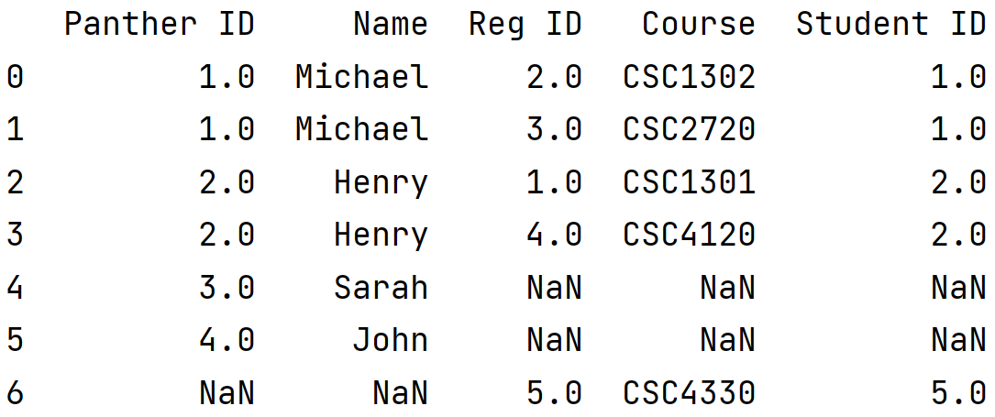
import pandas as pd student = pd.DataFrame([[1,'Michael'],[2,'Henry'],[3,'Sarah'],[4,'John']], columns=['Panther ID','Name']) registration = pd.DataFrame([[1,'CSC1301', 2],[2,'CSC1302', 1],[3,'CSC2720', 1],[4,'CSC4120', 2], [5,'CSC4330',5]], columns=['Reg ID','Course', 'Student ID’])
result = pd.merge(student, registration, how='outer’,
left_on='Panther ID',right_on='Student ID') print(result)
Outer join result

Slide 15
Reference
https://pandas.pydata.org/docs/reference/frame.html

Slide 16
Exercise 1: Merge the following two data frames using ‘inner’ join based on ‘member_id’ and ‘member’ columns of the left and right data frames respectively.
member_id | name | email
1 | A | a@gmail.com
2 | B | b@outlook.com
3 | C | c@yahoo.com
order_id | product | price | member
1000 | Laptop | 800 | 2
1001 | Phone | 700 | 1
1002 | Backpack | 50 | 4
1003 | Chair | 50 | 3
1004 | Guitar | 200 | 5
members
orders

Slide 17
result = pd.merge(members, orders, how=‘inner’, left_on=‘member_id',right_on=‘member')
order_id | product | price | member
1000 | Laptop | 800 | 2
1001 | Phone | 700 | 1
1002 | Backpack | 50 | 4
1003 | Chair | 50 | 3
1004 | Guitar | 200 | 5
member_id | name | email
1 | A | a@gmail.com
2 | B | b@outlook.com
3 | C | c@yahoo.com
Resulting DataFrame?

Slide 18
Attendance

